Slide 1
Introduction to HTML & CSS
Building Blocks of the web
Vaishnavi Tandel

Slide 2
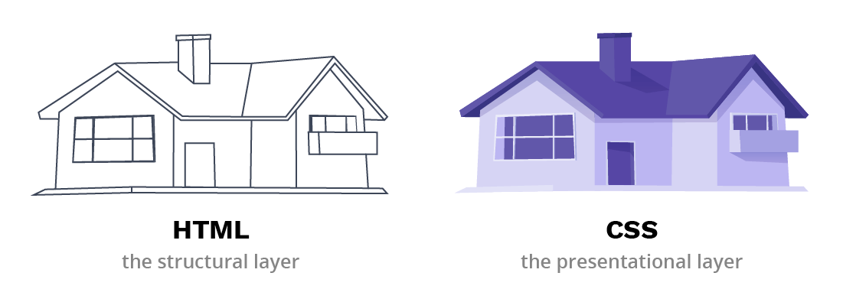
What is a Website?
A Collection of web pages viewed in a browser.
Built using HTML, CSS and Javascript.

Slide 3
What is HTML?
HTML stands for Hyper Text Markup Language.
It’s the skeleton of a webpage.
Uses tags like <p> <h1> <img> ,etc
Tells the browser what content is and how to organize it.

Slide 4
Common HTML Tags
Tags | Purpose
<h1> to <h6> | Headings
<p> | Paragraph
<a> | Link
<img> | Image
<ul> <ol> <li> | Lists

Slide 5
What is CSS?
CSS stands for Cascading Style Sheets.
Adds style, color, layout to HTML.
Separates content from design.
How to use CSS with HTML:
Inline
Internal
External

Slide 6
Basic CSS Properties
Property | Purpose
Color | Text Color
background-color | Background Color
Font-size | Size of text
Padding/ margin | Space inside and outside elements
border | Adds borders

